Slide 1


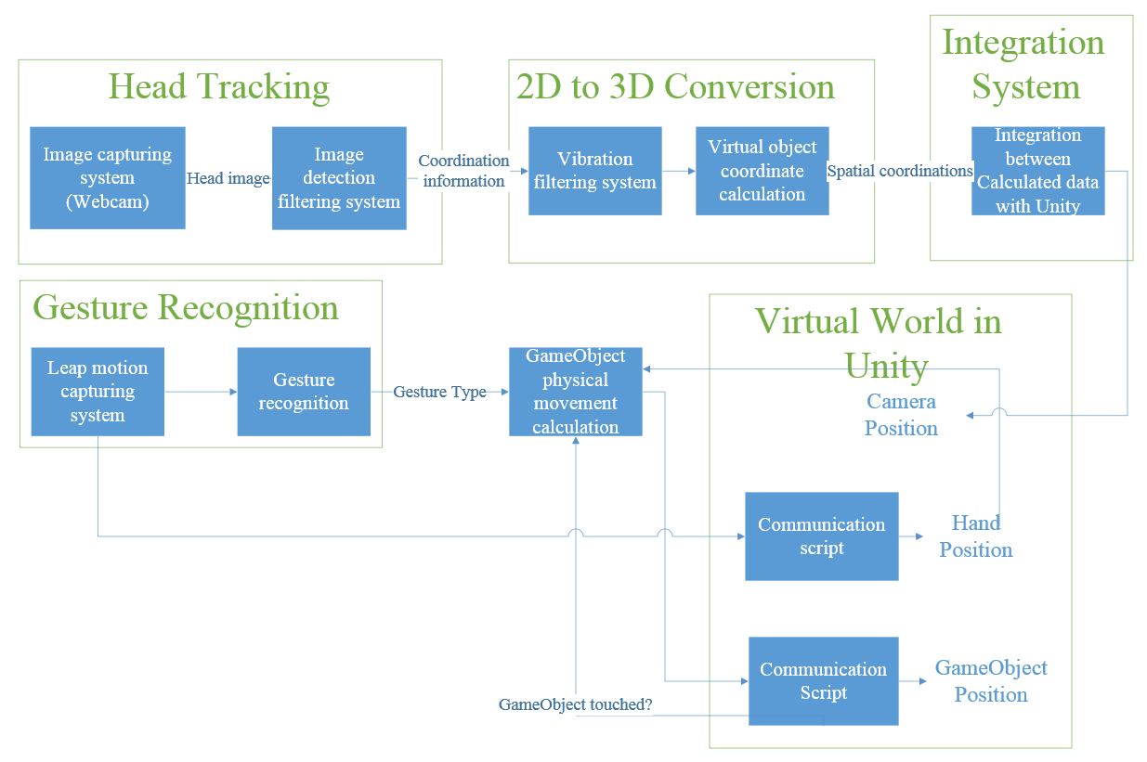
Virtual Reality Assisted Interior Design System
Group 52: Zhechen Du; Zhengfang Duanmu; Debin Li; Lingyun Li; Rui Pan
Background
System Diagram
Alternative design iteration
Over 70% of the home renovation involves some sort of Do-It-Yourself
Over 40% of those people are spending more than $1,000
Hard for everyday user to plan ahead of time and visualize the planned design
LED assisted head tracking – attach red LEDs to user’s head in order to get a position fix
Xbox Kinetic assisted facial detection and head tracking
Uses Xbox’s Kinetic system to detect faces and track body motions
Objective
Create an easy and intuitive way for users to interact with a virtual reality world to stimulate and assist with room renovation
User should be able to interact with the VR world, adding and moving objects in order to visualize different scenarios
Able to use the system in public places, like home renovation firms’ showroom
Create a versatile system that can be easily adapted to fit other purposes
Detailed design diagram for the Virtual Reality Assisted Interior Design System
Advantages
Design components
Offers user an interactive and intuitive way to visualize their room renovation project
The scenarios being rendered are not static; user can move around and see the render in different angles interactively
Easy and cheap to implement, low maintenance cost
Can be easily adapted to fit other purposes, like 3D molecule viewer for chemistry class, interactive anatomy viewer for biology class, etc.
Head Tracking system provides feedback for user’s head movement, used for displaying dynamic perspective
Unity Virtual World provides the 3D platform for the system to run on
Gesture Recognition system detects user’s gestures, and allowing the user to interact with the system
Design consideration
Scalable
Usability
Versatility
Flexibility
Maintainability
Consultant: Bernie Rohel

